Slide 1
Clipping Transformation
Course Title: Computer Graphics
Course Code: CSE – 413
Instructor: Khandaker Jannatul Ritu, Lecturer, Dept. of CSE(BAIUST)

Slide 2

Outlines
Introduction to Clipping
Point Clipping
Line clipping
1. Cohen Sutherland Line Clipping Algorithm
2. Midpoint Subdivision Line Clipping Algorithm
3. Liang-Barsky Line Clipping Algorithm
Polygon Clipping
1. Sutherland Hodgeman polygon clipping
2. Weiler Atherton polygon clipping
Curve Clipping
Exterior Clipping
Text Clipping

Slide 3
Question List

Slide 4
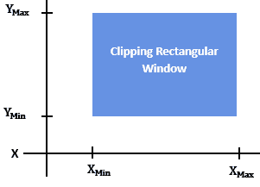
Clipping
The process of selecting and viewing the picture with different views is called windowing, and a process which divides each element of the picture into its visible and invisible portions, allowing the invisible portion to be discarded is called clipping.
Clipping: In computer graphics our screen act as a 2-D coordinate system. it is not necessary that each and every point can be viewed on our viewing pane(i.e. our computer screen). We can view points, which lie in particular range (0,0) and (Xmax, Ymax).
So, clipping is a procedure that identifies those portions of a picture that are either inside or outside of our viewing pane. In case of point clipping, we only show/print points on our window which are in range of our viewing pane, others points which are outside the range are discarded.
Any procedure that identifies those portions of a picture that are either inside or outside of a specified region of space is referred to as a clipping algorithm or simply clipping.
The region against which an object is to be clipped is called a clip window.
Clipping is the process to identify the picture either inside or outside of the displaying area.

Slide 5
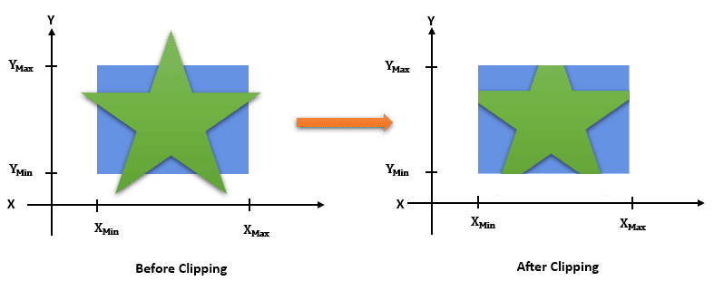
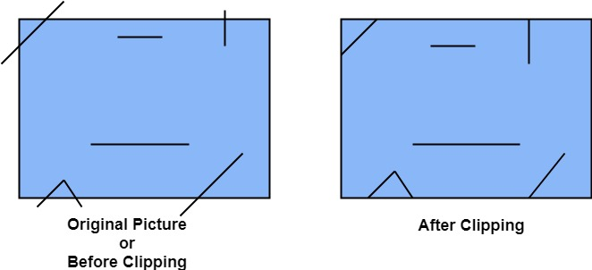
Settings
When we want to display a scene with only those objects within a particular rectangular window, we should first specify the window’s coordinates
({Y}_{Max}, {Y}_{Min},
{X}_{Max}, {X}_{Min})
Then. we clip the objects to show only their parts in the specified window.
The window against which object is clipped called a clip window. It can be curved or rectangle in shape.
Following figure show before and after clipping

Slide 6
Differences Between Windowing and Clipping in Computer Graphics
Windowing | Clipping
Defines a visible portion of the scene | Removes invisible or non-visible elements
Focuses on controlling the display area | Optimizes rendering performance
Enhances visual clarity and detail | Eliminates hidden surfaces and unnecessary computations
Enables focused visualization | Enhances realism and efficiency in virtual environments
Used in user interfaces, gaming, and virtual reality | Applied in rendering, virtual reality, and image processing
Allows for the display of multiple windows | Ensures proper alignment of virtual objects
Optimizes user experience | Improves rendering performance and efficiency
May require additional computational resources | Challenges in determining accurate clipping regions
Improper windowing may exclude important details | Improper clipping may result in visible artifacts or missing details
Complex scenes can present challenges in defining effective windows | Requires consideration of occlusion and object visibility

Slide 7
Why Do We Need Clipping?
The viewing window (or viewport) often has a limited display area. Moreover, when rendering complex scenes, it’s essential to optimize performance by discarding objects or parts of objects that viewers can’t see.
Clipping helps eliminate unnecessary calculations and improves the efficiency of rendering algorithms. Furthermore, it guarantees the display of only the visible portions of objects, resulting in faster rendering times and a more realistic representation of a scene.
When we have to display a large portion of the picture, then not only scaling & translation is necessary, the visible part of picture is also identified. This process is not easy. Certain parts of the image are inside, while others are partially inside. The lines or elements which are partially visible will be omitted. For deciding the visible and invisible portion, a particular process called clipping is used. Clipping determines each element into the visible and invisible portion. Visible portion is selected. An invisible portion is discarded.

Slide 8
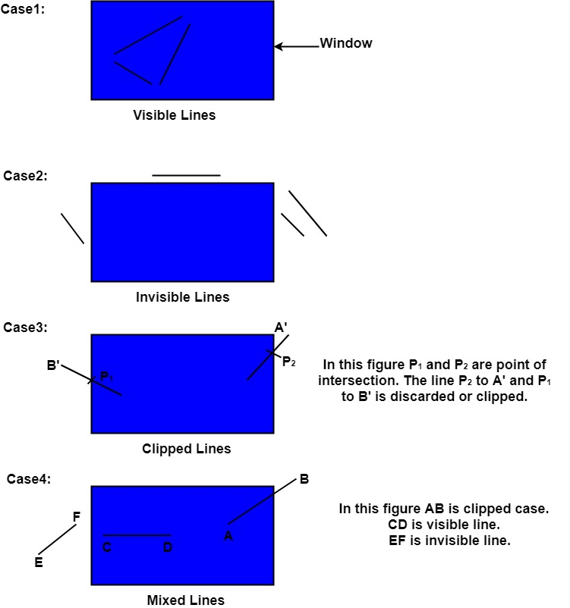
Types of Lines:
Lines are of three types:
Visible: A line or lines entirely inside the window is considered visible
Invisible: A line entirely outside the window is considered invisible
Clipped: A line partially inside the window and partially outside is clipped. For clipping point of intersection of a line with the window is determined.

Slide 9
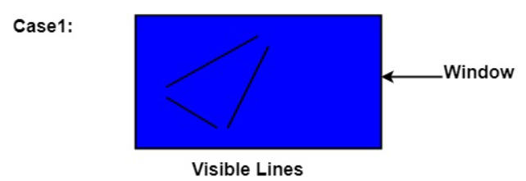
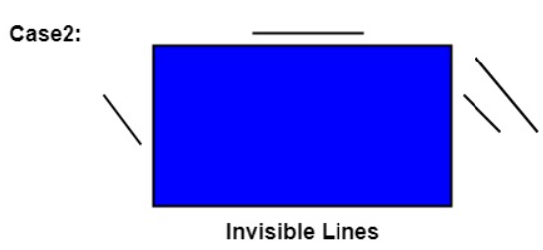
Conditions of Lines while performing window to view port transformation
There are three conditions that may occur while performing window to view port transformation:
Case 1: A simple line or lines entirely lie inside the window. Such lines are considered as visible lines
Case 2: A simple line lies entirely outside the window. Such lines are considered as invisible lines.

Slide 10
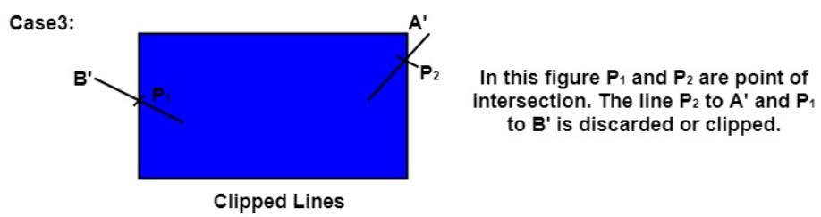
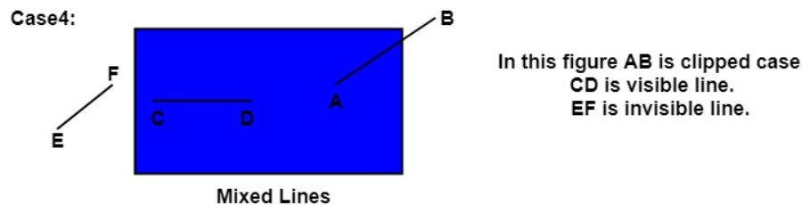
Case-3: A simple line partially lies inside the window and partially outside. In such conditions, we need to perform clipping. Thus, the clipping point of the intersection of a line with the window is determined
Case-4: So, for deciding the visible and invisible portion from the picture, clipping is performed on it. Clipping determines each element into the visible and invisible portion by omitting the extra part. So, the visible portion is selected. And an invisible portion is discarded.

Slide 11
Applications of clipping:
It will extract part we desire.
For identifying the visible and invisible area in the 3D object.
For creating objects using solid modeling.
For drawing operations.
Operations related to the pointing of an object.
For deleting, copying, moving part of an object.
Real-time rendering in video games: Clipping can optimize the performance by rendering only the visible portions of game objects, improving frame rates and overall gameplay experience.
CAD and architectural design: Clipping can also assist in displaying complex 3D models accurately, allowing designers to focus on the visible components during the design process.
Virtual reality (VR) and augmented reality (AR): Another application of clipping in ensuring that virtual or augmented objects are rendered realistically within the user’s field of view, enhancing the immersive experience.
Clipping can be applied to world co-ordinates. The contents inside the window will be mapped to device co-ordinates. Another alternative is a complete world co-ordinates picture is assigned to device co-ordinates, and then clipping of viewport boundaries is done.

Slide 12
Types of Clipping
Point Clipping: Performed on a point
Line Clipping: Performed on a line
Area Clipping (Polygon): Performed on various types of polygons
Curve Clipping: Performed on curved lines and shapes
Text Clipping: Performed on texts.
Exterior Clipping: Performed without knowing about the content of the image.

Slide 13
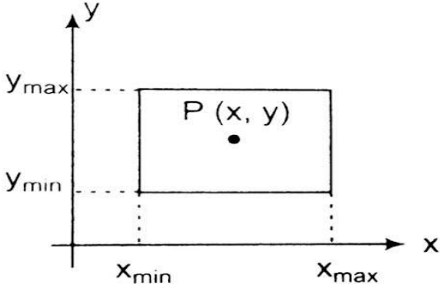
Point Clipping:
Point Clipping is used to determining, whether the point is inside the window or not. It is particularly useful when dealing with objects that have complex shapes or when displaying only a portion of an image.
For this following conditions are checked.
x ≤ x_{max}
x ≥ x_{min}
y ≤ y_{max}
y ≥ y_{min}
The (x, y) is coordinate of the point. If anyone from the above inequalities is false, then the point will fall outside the window and will not be considered to be visible.
For Example: Point clipping can be applied to the scene involving explosions that are modelled with particles (points) distributed in some region of the scene.

Slide 14
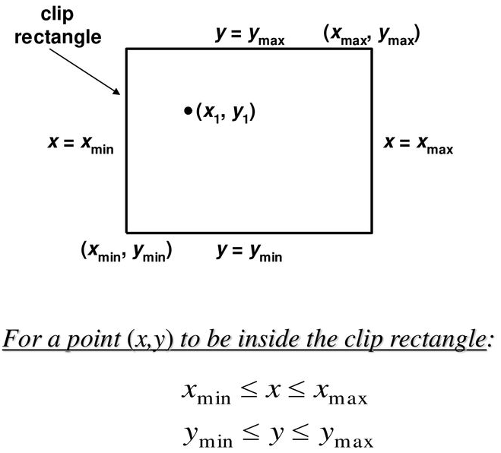
Point Clipping Algorithm:
Get the minimum and maximum coordinates of both viewing pane.
Get the coordinates for a point.
Check whether given input lies between minimum and maximum coordinate of viewing pane.
If yes display the point which lies inside the region otherwise discard it.

Slide 15
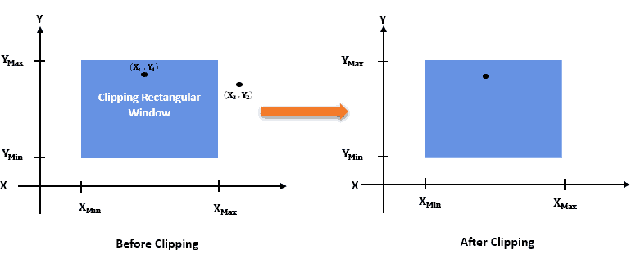
Point Clipping:

Slide 16
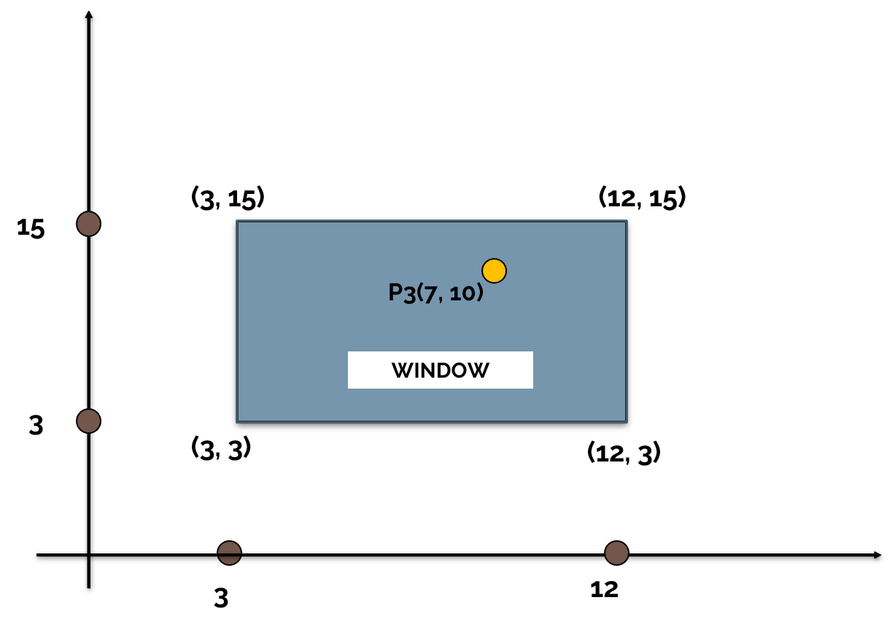
Example-01: Suppose that the coordinates of the two opposite corners of the clip window are
(XWmin, YWmin) = (3, 3) and (XWmax, YWmax) = (12, 15).
The input points on the window are:- P1 = (7, 10)
Plot all the points and find which of the above points will be clipped?
Solution:
P1 will not be clipped: Inside the window
For P1 : 3 ≤ 7 ≤ 12 and 3 ≤ 10 ≤ 15

Slide 17
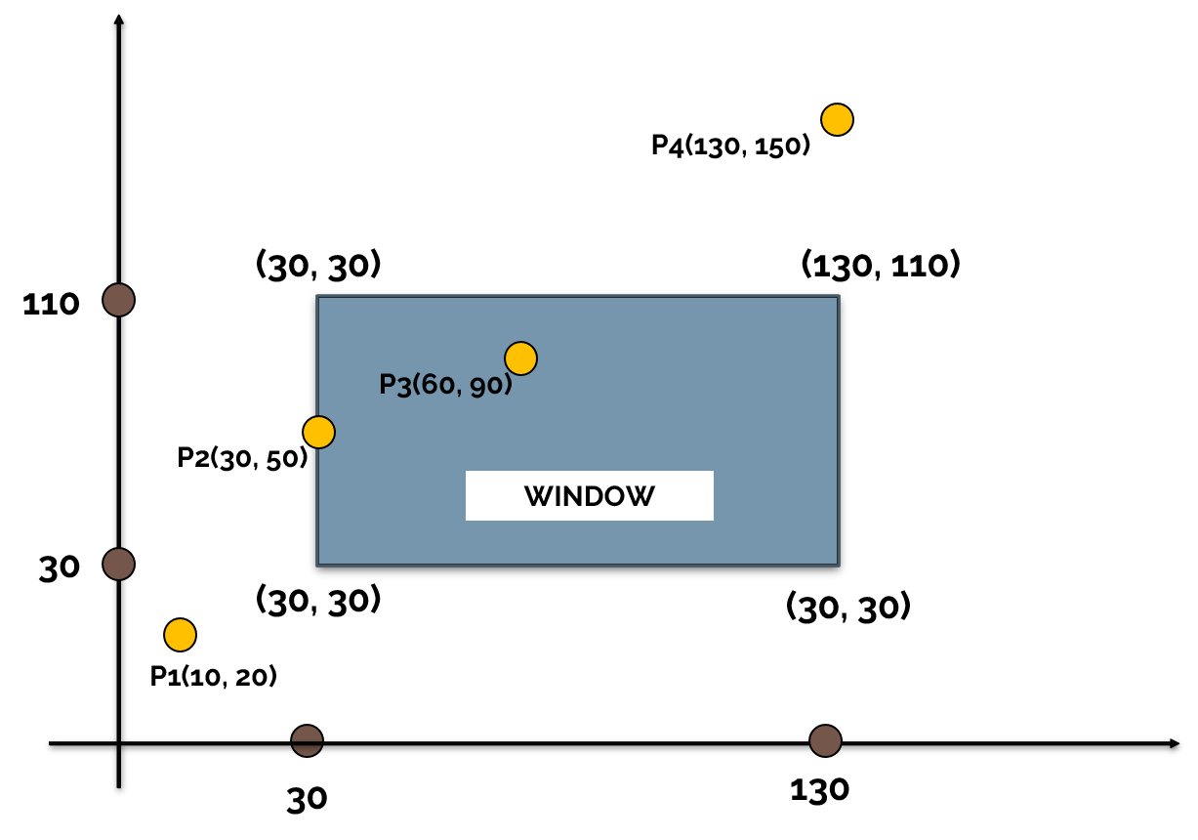
Example-02: Suppose that the coordinates of the two opposite corners of the clip window are
(XWmin, YWmin) = (30, 30) and (XWmax, YWmax) = (130, 110).
The input points on the window are:- P1 = (10, 20), P2 = (30, 50), P3 = (60, 90), P4 = (130, 150)
Plot all the points and find which of the above points will be clipped?
Solution:
P1 will be clipped: Outside the window
For P1 : 30 > 10 ≤ 130 and 30> 20 ≤ 110
P2 will not be clipped: Inside the window
For P2 : 30 ≤ 30 ≤ 130 and 30 ≤ 50 ≤ 110
P3 will not be clipped: Inside the window
For P3 : 30 ≤ 60 < 130 and 30 ≤ 90 < 110
P4 will be clipped: Outside the window
For 4 : 30 ≤ 130 ≤ 130 and 30 ≤ 150 > 110

Slide 18
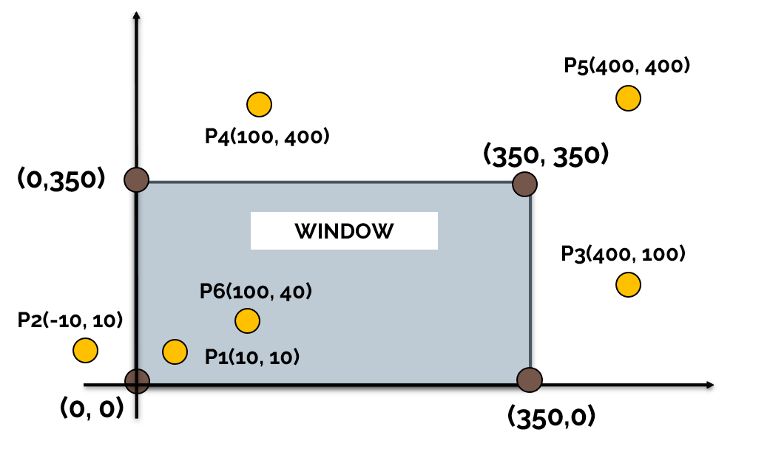
Example-03: Suppose that the coordinates of the two opposite corners of the clip window are
(XWmin, YWmin) = (0, 0) and (XWmax, YWmax) = (350, 350).
The input points on the window are:- P1 = (10, 10), P2 = (-10, 10), P3 = (400, 100), P4 = (100, 400),
P4 = (400, 400), P4 = (100, 40).
Plot all the points and find which of the above points will be clipped?
Solution:
P1 will not be clipped: Inside the window
For P1 : 0 ≤ 10 ≤ 350 and 0 ≤ 10 ≤ 350
P2 will be clipped: Outside the window
For P2 : 0 > -10 ≤ 350 and 0 ≤ 10 ≤ 350
P3 will be clipped: Outside the window
For P3 : 0 ≤ 400 > 350 and 0 ≤ 100 ≤ 350
P4 will be clipped: Outside the window
For P4 : 0 ≤ 100 ≤ 350 and 0 ≤ 400 > 350
P3 will be clipped: Outside the window
For P5 : 0 ≤ 400 > 350 and 0 ≤ 400 > 350
P4 will not be clipped: Inside the window
For P6 : 0 ≤ 100 ≤ 350 and 0 ≤ 40 ≤ 350

Slide 19
Advantage
1. Versatility: The algorithm can be applied to a wide range of objects, including points, lines, polygons, and other complex shapes. This makes it a versatile tool for a wide range of applications.
2. Efficiency: The algorithm is relatively efficient and can be used to quickly identify and remove points that lie outside a specified region or boundary. This can help improve the performance of computer graphics applications, particularly those that involve rendering large or complex scenes.
3. Accuracy: The Point Clipping Algorithm can be used to accurately clip objects and ensure that only the portions of an object that are visible or relevant are displayed. This can help improve the visual quality of images and animations.
4. Flexibility: The algorithm can be easily adapted to different applications and scenarios. For example, different variants of the algorithm can be used to clip points, lines, and polygons, and to handle different types of regions and boundaries.
5. Ease of Implementation: The algorithm is relatively straightforward to implement and can be integrated into computer graphics applications with minimal effort. This makes it an attractive option for developers who want to add clipping functionality to their applications.

Slide 20
Dis-Advantages
Limited to 2D: The algorithm is designed to work in two dimensions, and it may not be suitable for handling objects in three-dimensional space. This can limit its usefulness in some applications, such as 3D modeling and virtual reality.
Complexity: Some variants of the algorithm, such as the Cyrus-Beck algorithm, can be relatively complex and require a significant amount of computational resources to execute. This can make them less efficient than other algorithms, particularly for large or complex objects.
Precision Issues: The algorithm can suffer from precision issues, particularly when dealing with objects that are very small or have complex shapes. This can result in clipping errors or inaccuracies in the rendered image.
Performance: Although the algorithm is relatively efficient, it can still have a significant impact on the performance of a computer graphics application, particularly if it is used to clip a large number of objects.
Limitations: The algorithm is limited in its ability to handle certain types of objects or regions. For example, it may not be suitable for handling objects with concave shapes or regions that are defined by curved boundaries.

Slide 21
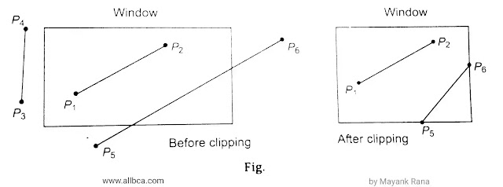
2. Line Clipping: A line clipping procedure involves several parts. First, we can test a given line segment to determine whether it lies completely inside the clipping window if it does not, we try to determine whether it lies completely outside the window.
Finally, if we cannot identify a line segment as completely inside or completely outside we must perform intersection calculations with one or more clipping boundaries.
A line with both endpoints insides all clipping boundaries, such as the line P1 to P2 is saved. A line with both endpoints outside any one of the clip boundaries (line P3 P4) is outside the window.
We can define the line clipping algorithm to set the portion of the line to be seen into the define viewport area. But due to the presence of two points (i.e., end points) it is different from point clipping.

Slide 22
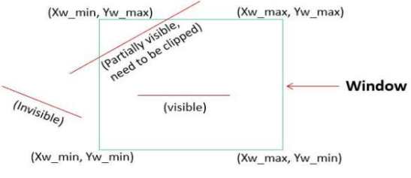
To decide whether the line can be viewed or not or whether some portion of the line can be viewed on the viewport, the following steps are followed:
If both the endpoints of a line are outside the viewing area, it can’t be displayed.
And if both the endpoints of a line are inside the viewing area, the complete line will be visible.
If some portions of the line or one or two endpoints is outside the viewing area, the portion of the line is to be displayed.
This can be illustrated by the following figure.
Line Clipping is performed by using the line clipping algorithm. The line clipping algorithms are:
Cohen Sutherland Line Clipping Algorithm
Midpoint Subdivision Line Clipping Algorithm
Liang-Barsky Line Clipping Algorithms

Slide 23
Cohen Sutherland Line Clipping Algorithm:

Slide 25
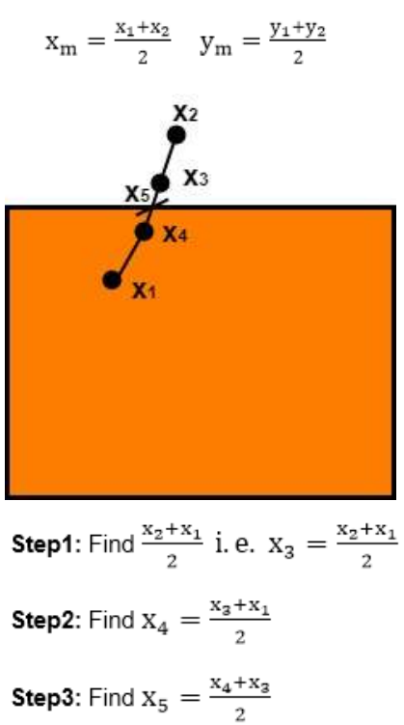
Midpoint Subdivision Algorithm
This algorithm is mainly used to compute visible areas of lines that are present in the view port are of the sector or the image. It follows the principle of the bisection method and works by bisecting the line in to equal halves but bisects the line numerous times.
Like other algorithm, initially the line is tested for visibility.
If line is completely visible it is drawn and if it is completely invisible it is rejected.
If line is partially visible then it is subdivided in two equal parts.
The visibility tests are then applied to each half.
This subdivision process is repeated until we get completely visible and completely invisible line segments.
Let (xi,yi) are midpoint
X5 lie on point of intersection of boundary of window.

Slide 26
Difference between cohen sutherland and midpoint subdivision algorithm for line clipping:
The Cohen - Sutherland algorithm:
• The Cohen - Sutherland algorithm divides 2D space into 9 bits, using an infinite extension of the four linear limits of the frame.
• This seems to 'calculate intersections' along a 'line path', and each calculation involves both a 'division and a multiplication’.
The Midpoint subdivision algorithm:
• The 'Midpoint subdivision algorithm' is mainly used to calculate the visible area of the line that is 'present in the view port' of the 'sector or the image’.
• It takes the principle of the bisection technique by bisecting the line into equivalent division. 'Midpoint Subdivision Algorithm' bisects the line many times.

Slide 27
Algorithm of midpoint subdivision Line Clipping:
Step1: Calculate the position of both endpoints of the line
Step2: Perform OR operation on both of these endpoints
Step3: If the OR operation gives 0000 then Line is guaranteed to be visible else Perform AND operation on both endpoints. If AND ≠ 0000 then the line is invisible else AND=6000 then the line is clipped case.
Step4: For the line to be clipped. Find midpoint
Xm=(x1+x2)/2
Ym=(y1+y2)/2
Xm → midpoint of X coordinate.
Ym → midpoint of Y coordinate.
Step5: Check each midpoint, whether it nearest to the boundary of a window or not.
Step6: If the line is totally visible or totally rejected not found then repeat step 1 to 5.
Step7: Stop algorithm

Slide 31
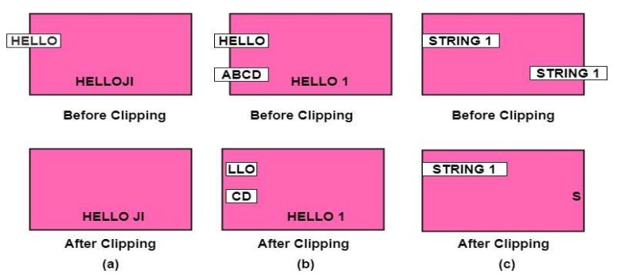
Text Clipping
Several methods are available for clipping of text. Clipping method is dependent on the method of generation used for characters. A simple method is completely considered, or nothing considers method. This method is also called as all or none. If all characters of the string are inside window, then we will keep the string, if a string character is outside then whole string will be discarded in fig (a).
Another method is discarded those characters not completely inside the window. If a character overlap boundary of window. Those will be discarded in fig (b).
In fig (c) individual character is treated. Character lies on boundary is discarded as which it is outside the window.

Slide 32
Polygon Clipping
Polygon clipping is applied to the polygons. The term polygon is used to define objects having outline of solid. These objects should maintain property and shape of polygon after clipping.
“A Polygon can be described as the enclosed collection or group of the lines.”
In a polygon, all lines are connected. Lines can be a combination of edges and vertices, which together form a polygon. A polygon refers to a two-dimensional architecture made up of a number of straight lines.
Some Examples of the polygon:
• Triangles
• Pentagons
• Hexagons
• Quadrilaterals
The polygon’s name defines how many sides the architecture contains

Slide 33
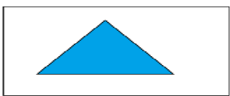
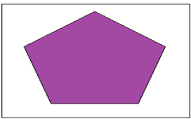
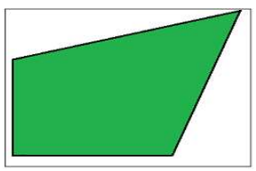
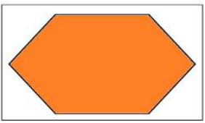
Triangle: It has three sides.
Pentagon: A pentagon has five sides.
Hexagon: It contains six sides.
Quadrilaterals: It contains four sides.

Slide 34
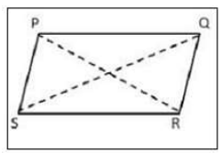
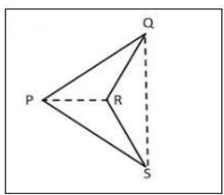
Types of Polygon
There are two basic types of polygon-
• Concave Polygon
• Convex Polygon
Concave Polygon: The concave polygon does not have any part of its diagonals in its exterior. In a concave polygon, at least one angle should be greater than 180° (angle >180°).
Convex Polygon: The convex polygon has at least one part of diagonal in its exterior. In a convex polygon, all the angles should be less than 180° (angle<180°).

Slide 35
Polygon Clipping
Polygon clipping is a process in which we only consider the part which is inside the view pane or window. We will remove or clip the part that is outside the window.
We will use the following algorithms for polygon clipping:–
Sutherland-Hodgeman polygon clipping algorithm
Weiler-Atherton polygon clipping algorithm
Curve Clipping
Curve Clipping involves complex procedures as compared to line clipping. Curve clipping requires more processing than for object with linear boundaries. Consider window which is rectangular in shape. The circle is to consider against rectangle window. If circle is completely inside boundary of the window, it is considered visible. So, save the circle. If a circle is in outside window, discard it. If circle cut the boundary then consider it to be clipping case.

Slide 36
Exterior Clipping
It is opposite to previous clipping. Here picture which is outside the window is considered. The picture inside the rectangle window is discarded. So, part of the picture outside the window is saved.
Uses of Exterior Clipping:
• It is used for displaying properly the pictures which overlap each other.
• It is used in the concept of overlapping windows.
• It is used for designing various patterns of pictures.
• It is used for advertising purposes.
• It is suitable for publishing.
• For designing and displaying of the number of maps and charts, it is also used.

